Slide 1

7th Grade Math
Unit 1, Lesson 5 Solving One-Step Equations Volume 1, pg. 25

Slide 2


Benchmarks
MA.6.AR.2.2
Write and solve one-step equations in one variable within a mathematical or real-world context using addition and subtraction, where all terms and solutions are integers.
MA.6.AR.2.3
Write and solve one-step equations in one variable within a mathematical or real-world context using multiplication and division, where all terms and solutions are integers.
volume 1, pg. 25

Slide 3
Integrated Mathematical Thinking and Reasoning Standards
MA.K12.MTR.1.1 Actively participate in effortful learning both individually and collectively.
MA.K12.MTR.2.1 Demonstrate understanding by representing problems in multiple ways.
MA.K12.MTR.4.1 Engage in discussions that reflect on the mathematical thinking of self and others.
volume 1, pg. 25

Slide 4

Learning Target
I can solve one-step equations involving addition, subtraction, multiplication, and division using models and inverse operations.
volume 1, pg. 25

Slide 5

Warm-Up
volume 1, pg. 25

Slide 6
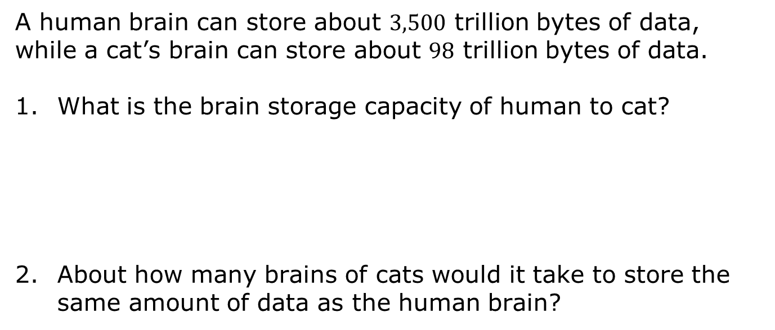
1.5.1 Warm-Up: Brain Capacity
A human brain can store about $3,500$ trillion bytes of data, while a cat’s brain can store about $98$ trillion bytes of data.
What is the brain storage capacity of human to cat?
About how many brains of cats would it take to store the same amount of data as the human brain?
volume 1, pg. 25

Slide 7

Guided Practice
volume 1, pg. 26

Slide 8

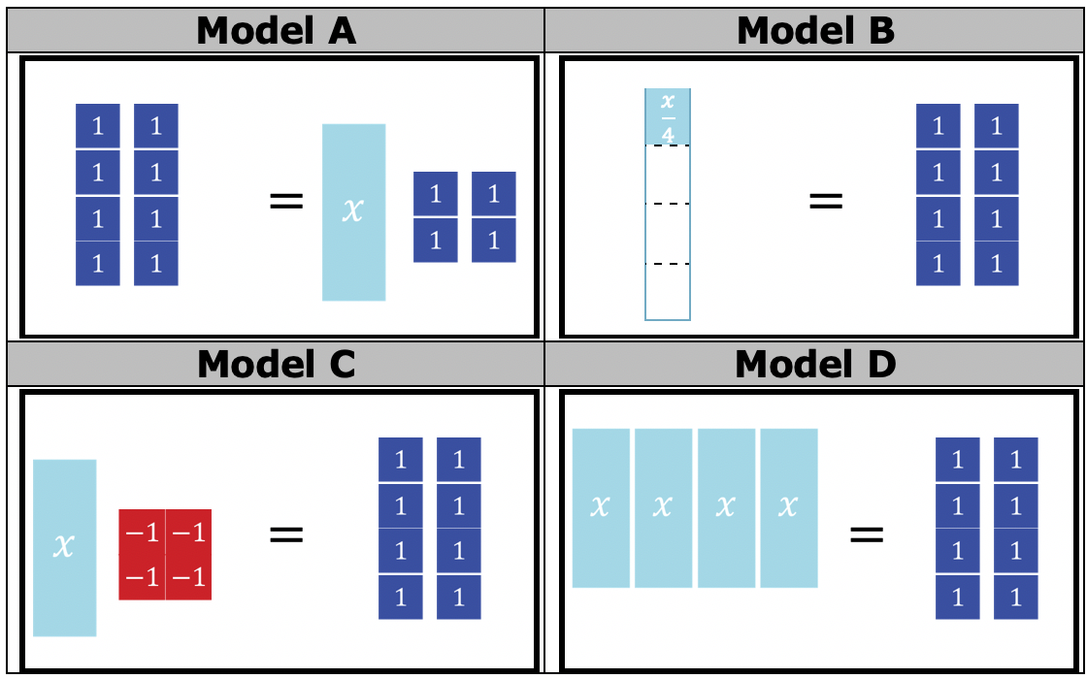
1.5.2 Guided Practice: Solving Equations
Four algebraic equations are represented using algebra tiles.
volume 1, pg. 26

Slide 9
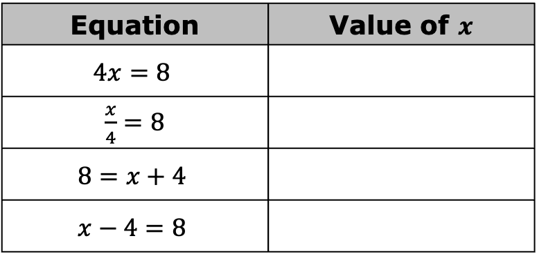
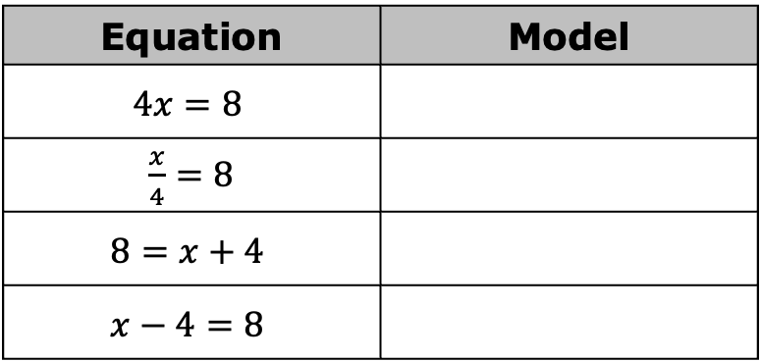

Match the algebra tile model to the equations.
Use the algebra tile models to determine the value of $x$ in each equation.
Equation | Model
$$4x=8$$
$\frac{x}{4}=8$
$$8=x+4$$
$$x−4=8$$
Equation | Value of $x$
$$4x=8$$
$\frac{x}{4}=8$
$$8=x+4$$
$$x−4=8$$
volume 1, pg. 26

Slide 10
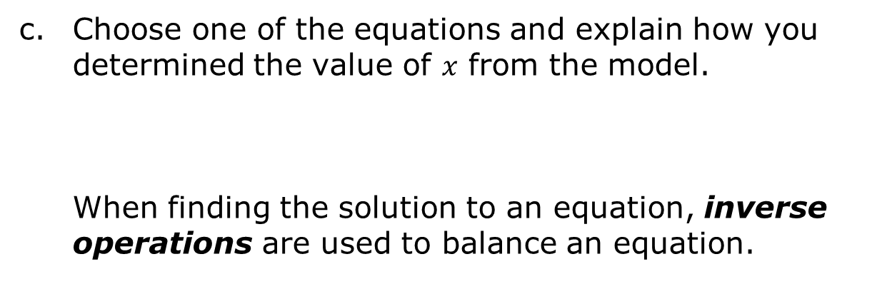
Choose one of the equations and explain how you determined the value of $x$ from the model.
When finding the solution to an equation, inverse operations are used to balance an equation.
An inverse operation is an operation that reverses the effect of another operation.
volume 1, pg. 26

Slide 11
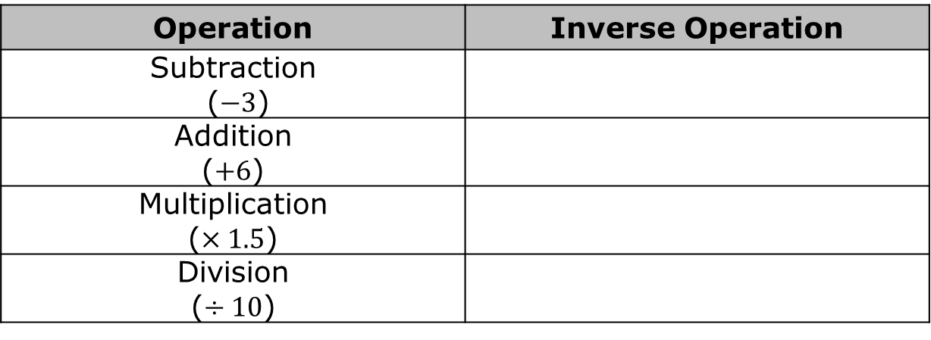

Using the definition of inverse operations, complete the table to indicate which operation would reverse the given operation.
Use the equation $21=7h$ to complete the following.
What mathematical operation is represented by $7h$?
What is the inverse operation?
Operation | Inverse Operation
Subtraction ($−3$)
Addition ($+6$)
Multiplication ($×1.5$)
Division ($÷10$)
volume 1, pg. 27

Slide 12
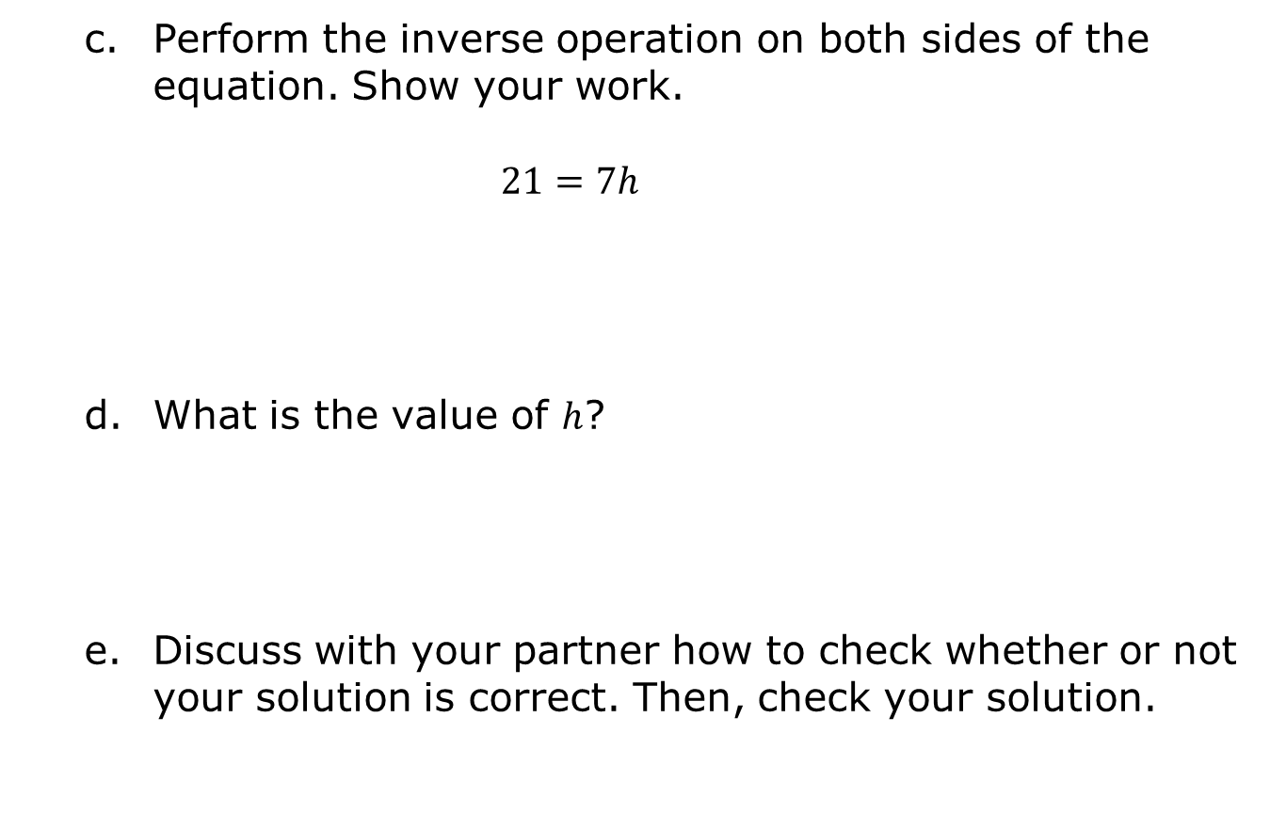
Perform the inverse operation on both sides of the equation. Show your work. $21=7h$
What is the value of $h$?
Discuss with your partner how to check whether or not your solution is correct. Then, check your solution.
volume 1, pg. 27

Slide 13
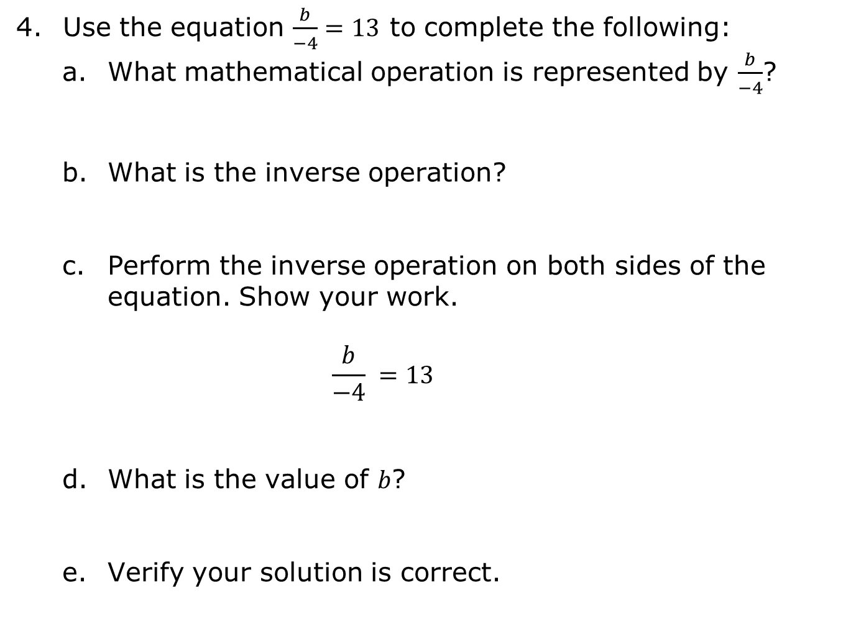
Use the equation $\frac{b}{−4}=13$ to complete the following:
What mathematical operation is represented by $\frac{b}{−4}$?
What is the inverse operation?
Perform the inverse operation on both sides of the equation. Show your work. $\frac{b}{−4} =13$
What is the value of $b$?
Verify your solution is correct.
volume 1, pg. 27

Slide 14

Collaboration
volume 1, pg. 28

Slide 15

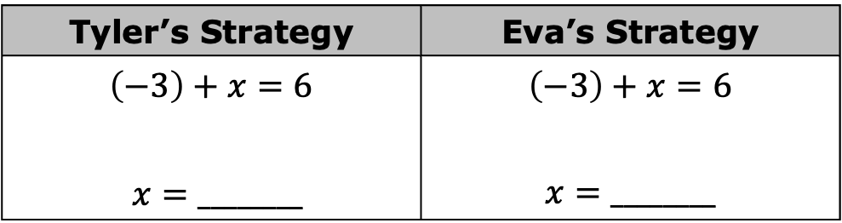
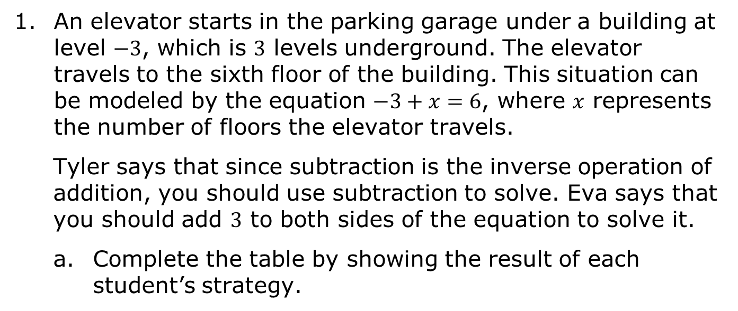
1.5.3 Collaboration: Choose a Strategy
An elevator starts in the parking garage under a building at level $−3$, which is $3$ levels underground. The elevator travels to the sixth floor of the building. This situation can be modeled by the equation $−3+x=6$, where $x$ represents the number of floors the elevator travels.
Tyler says that since subtraction is the inverse operation of addition, you should use subtraction to solve. Eva says that you should add $3$ to both sides of the equation to solve it.
Complete the table by showing the result of each student’s strategy.
Tyler’s Strategy | Eva’s Strategy
$$\left(−3\right)+x=6$$ $x=________$ | $$\left(−3\right)+x=6$$ $$x=________$$
volume 1, pg. 28

Slide 16
With your partner, determine whose strategy is correct. Explain how you know.
volume 1, pg. 28

Slide 17

Try It
volume 1, pg. 28

Slide 18

1.5.4 Try It: Solving Equations
Each equation shown in the table can be solved in one step. Complete the table by describing how to solve each equation, showing your work, and providing the solution. The first row is started for you.
volume 1, pg. 28

Slide 19
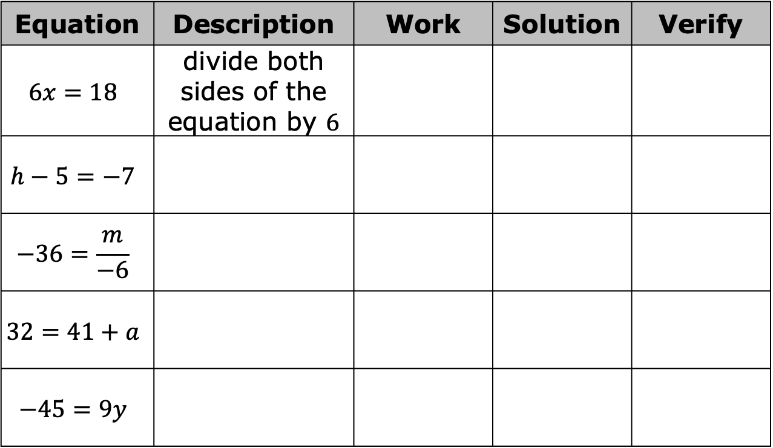
Equation | Description | Work | Solution | Verify
$$6x=18$$ | divide both sides of the equation by $6$
$$h−5=−7$$
$$−36=\frac{m}{−6}$$
$$32=41+a$$
$$−45=9y$$
Compare your work with your partner and resolve any differences. Verify your solutions using substitution.
volume 1, pg. 28

Slide 20
Collaboration
volume 1, pg. 29

Slide 21
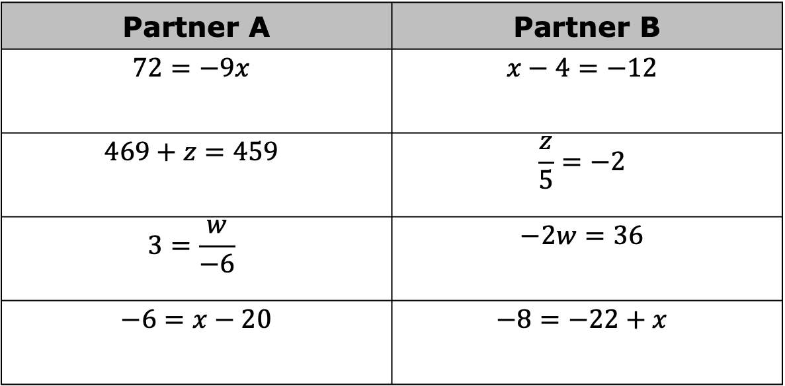
1.5.5 Collaboration: Solving Equations
With your partner, determine who will be Partner A and who will be Partner B.
Solve the equations from your designated column.
Partner A | Partner B
$$72=−9x$$ | $$x−4=−12$$
$$469+z=459$$ | $$\frac{z}{5}=−2$$
$$3=\frac{w}{−6}$$ | $$−2w=36$$
$$−6=x−20$$ | $$−8=−22+x$$
volume 1, pg. 29

Slide 22
The equations in each row have the same solutions. Check your work with your partner, making revisions to your work if necessary.
volume 1, pg. 29

Slide 23

Wrap-Up
volume 1, pg. 29

Slide 24
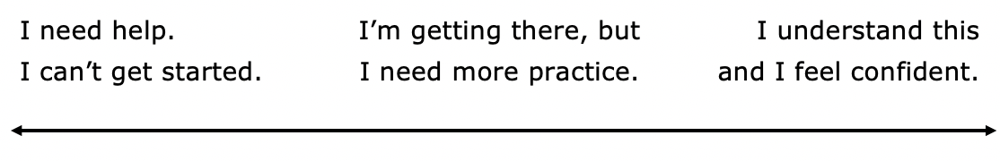
1.5.6 Wrap-Up: Reflection
Draw an X on each line to indicate where your current learning is related to each target.
I can solve one-step equations involving addition and subtraction.
I can one-step equations involving multiplication and division.
volume 1, pg. 29

